Slide 1
Floyd-Warshall’s algorithm
All pair shortest path problem
  Given a directed graph G=<V, E>, find the shortest path between any pair of nodes.
Data structure
  The nodes of G are numbered from 1 to N.
  A matrix W given the length/weight of each edge
    W[i,i] = 0
    W[i,j] =  if the edge (i,j) does not exist.

Slide 2
The key idea
The principle of optimality
  If k is a node on the shortest path from i to j, then the part of the path from i to k and the part from k to j must also be optimal
Construct a series of matrices of D_{k}, k=1,2,..,n, where D_{k}[i,j] is the distance of the shortest path from i to j that only use node {1, 2,…, k} as intermediate nodes.
  D_{k}[i,j] = min(D_{k-1}[i,j], D_{k-1}[i,k]+ D_{k-1}[k,j])
D_{k-1}[i,j]
i
j
D_{k-1}[i,k]
k
D_{k-1}[k,j]

Slide 3
Floyd’s algorithm
Floyd(int W[1..n][1..n])
{
D = W;
π = 0;
for (k=1; k<=n; k++)
for (i=1; i<=n; i++)
for (j=1; j<=n; j++)
if (D[i][k]+D[k][j] < D[i][j]) {
D[i][j] = D[i][k]+D[k][j];
π[i][j] = k;
}
}
Track the
shortest path
Cost: Θ(V³)
Why can we use just one array D?

Slide 4
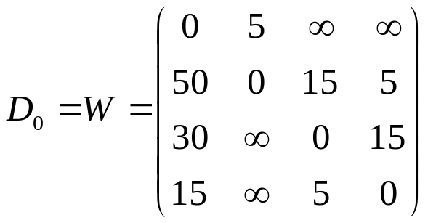
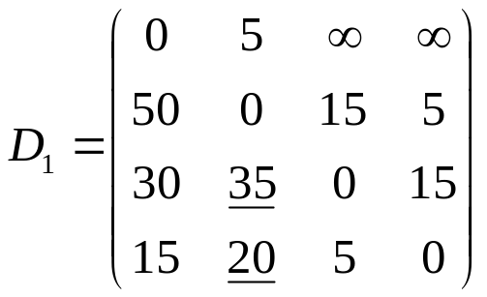
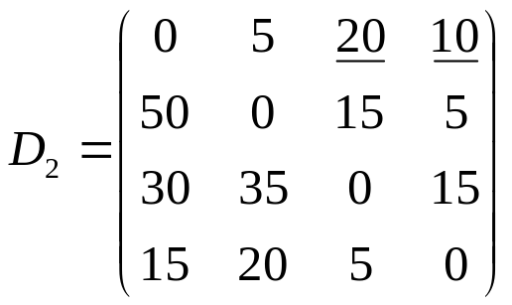
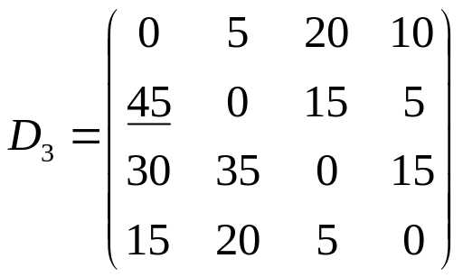
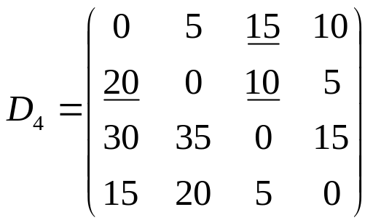
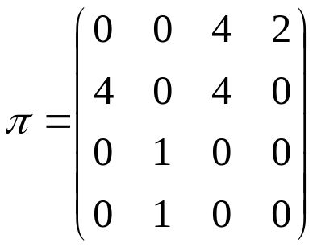
Example
1
15
4
5
5
50
30
5
15
2
3
15

Slide 5
Find the shortest path
// Print shortest path between
nodes i and j
printShortestPath(int i, int j)
{
print i;
printIntermediateNodes(i, j);
print j;
}
// Print intermediate nodes in the shortest
path between nodes i and j
printIntermediateNodes(int i, int j)
{
int k = p[i][j];
if (k == 0)
return;
else {
printIntermediateNodes(i, k);
print k;
printIntermediateNodes(k, j);
}
}
Find the shortest path between nodes 1 and 3 for the example.

Slide 6
Comparison
Applying Dijkstra’s algorithm on every node
  If use a matrix of distances, V*Θ(V²)= Θ(V³). Same asymptotic cost, but higher hidden constant
  If use a heap, V*Θ(Elog V)= Θ(VElog V).
    If E is close to V², Floyd’s algorithm is better
    If E << V², it is preferable to use Dijkstra’s algorithm n times

